Slide 1
DDoS Detection and Mitigation using Machine Learning
By
Arpit Gawande
Written under the guidance of
Dr. Jean-Camille Birget

Slide 2
DDoS Attacks and Challenges
What is a DDoS attack?
Disable host by jamming network or its resources.
Types
Volume-based. (TCP/IP)
Application-based. (DNS, VoIP, HTTP)
Low-rate.
Challenges in dealing with DDoS attacks
Many participating systems at different regions (Bots).
IP spoofing (Source address is not reliable).
Existing systems (expensive, incompatibile, interdependent)

Slide 3
DDoS Detection and Mitigation
How to Detect?
Identify anomalous behavior in the traffic.
At server, at ISP or at router.
How to Mitigate?
Block anomalous packets reaching their destination.

Slide 4
Routers
Creates network.
Forward packets.
Communicate using Internet Control Message Protocol (ICMP) or other similar protocols.
Can provide geographical information.
All routers combine can provide necessary knowledge about the packet flow (number of packets going to a destination) and the flow path (to the destination).
Role of a router in the detection and mitigation of a DDoS attack.
Single system, no extra setup cost, fast communication using existing protocols.

Slide 5
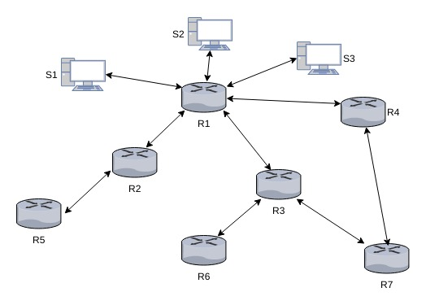
Network Diagram

Slide 6
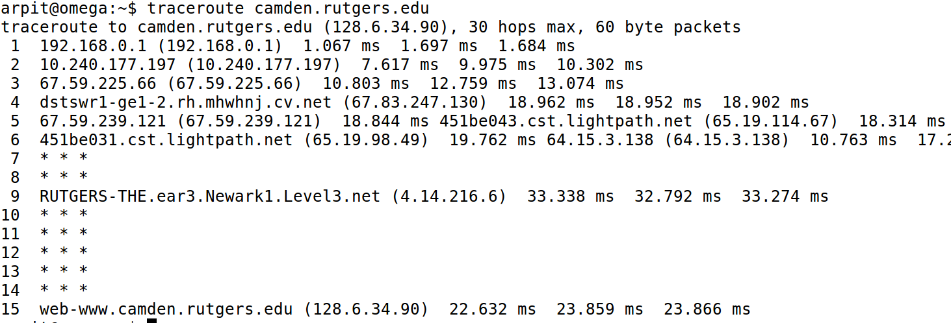
Trace Route

Slide 7
Thesis Approach
The router as a point of analysis.
Detection.
Understand flow behavior using learning techniques which don't use lots of resources.
Mitigation.
Know the source of an attack or the path of the packet travel using existing communication protocols.

Slide 8
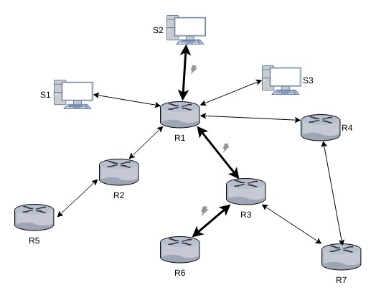
DDoS Attack Path

Slide 9
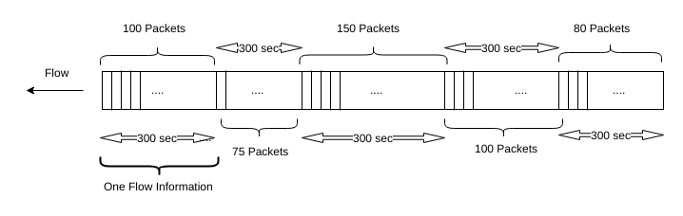
Flow capturing at the router
What is a flow?
A flow consists of several Internet packets captured during a fixed time interval.
Flow information is a basis for analysis.

Slide 10
Analysis Techniques
Modular approach
IP packet capturing.
Packet filtering.
Creating feature vectors.
Clustering.
Detecting anomaly in the clusters.

Slide 11
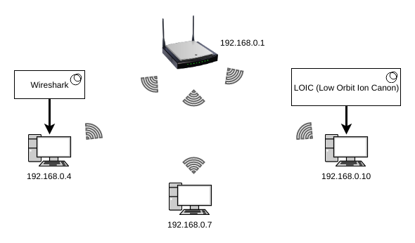
Implementation
Volumed-based DDoS attack analysis.
Use of bots to launch an attacks.
Tools used.
Low Orbit Ion Cannon (LOIC).
Wireshark.

Slide 12
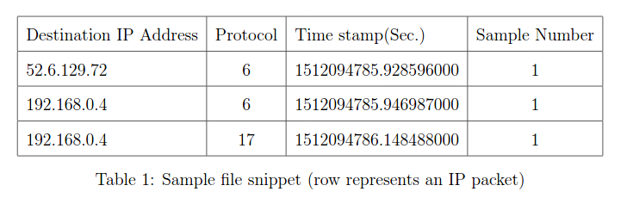
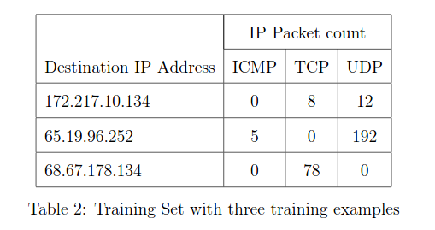
Captured Data and Training Set

Slide 13
Machine Learning
According to Tom Mitchell (1998), a computer program is said to learn from an experience E with respect to some task T and some performance measure P, if its performance on T, as measured by P, improves with experience.
Supervised Learning.
Unsupervised Learning.

Slide 14
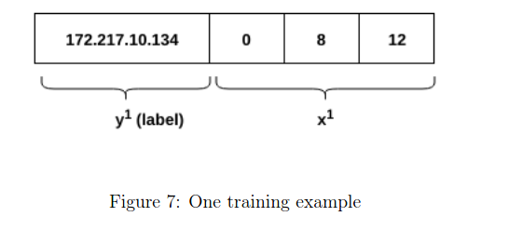
Training Example

Slide 15

Clustering
Feature Scaling
Lloyd's k-means algorithm
Arbitrarily choose initial k centers (centroids).
Label each training set with a center which is nearest to it.
Recalculate the center by taking mean over all the point which are labeled with that center.
Repeat assignment and recalculation steps until centers dont move.

Slide 16
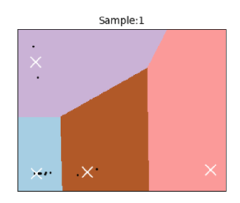
Clustering Continued..
We have multiple training sets.
Cluster each training set using k-means++ algorithm.
Determine number of clusters using elbow method.
Find centroids for each training set.
Get mean centroid by finding median and removing outliers.
Use the newly calculated centroid to cluster training sets.

Slide 17
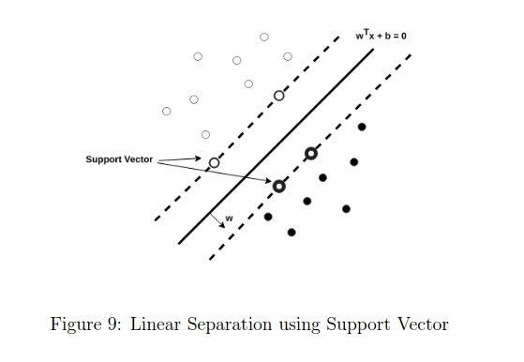
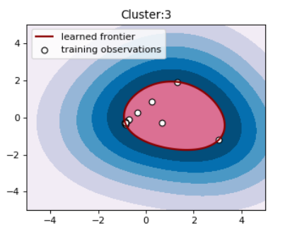
Anomaly Detection using One Class Support Vector Machine
How to handle situation where IP is assigned to same cluster?
Create a boundary around a cluster.
Label training sets in a cluster with the cluster number.
Use One Class Support Vector Machine (SVM) to define boundaries around the clusters.

Slide 18
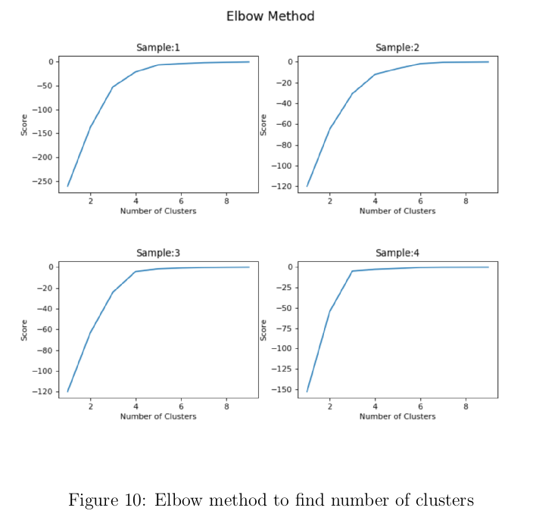
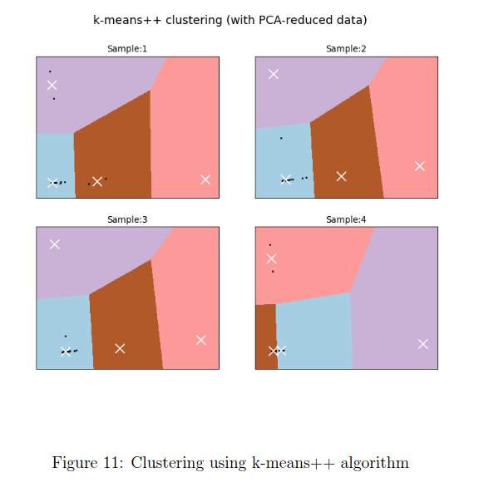
Detection Simulation

Slide 19
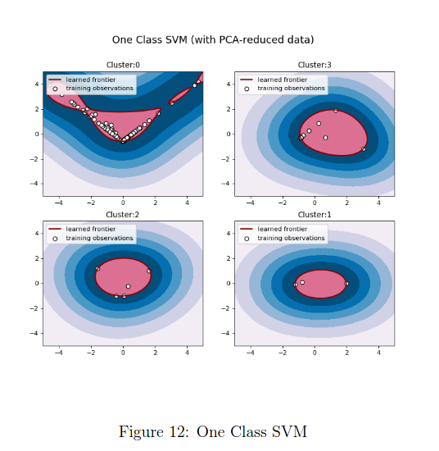
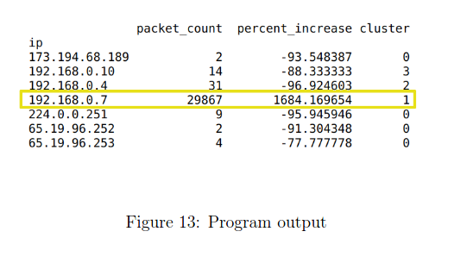
Detection Simulation Continued...

Slide 20
Mitigation
Install detection program on every router.
Network Function Virtualization (NFV) can help to add functionality to the networking devices remotely.
Block all the packets traveling to destination under attack (Given by Detection program).
For more informed decision, communicate detection information with server or with other routing devices.

Slide 21
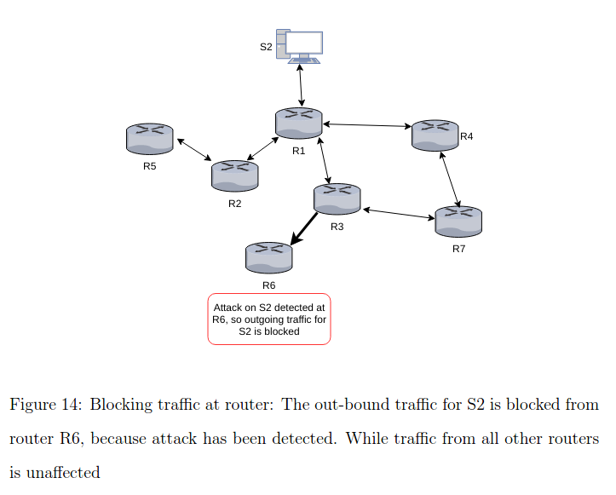
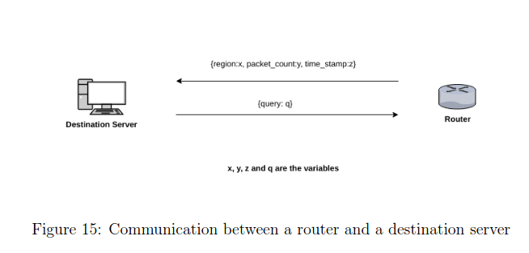
Mitigation Continued...

Slide 22
Conclusion
DDoS attacks are real threat to everyone on the Internet.
Difficult detection due to spoofing.
Use of router is an efficient way to detect and mitigate a DDoS attack (using Machine Learning tools).

Slide 23
Thank You!

